Slide 1
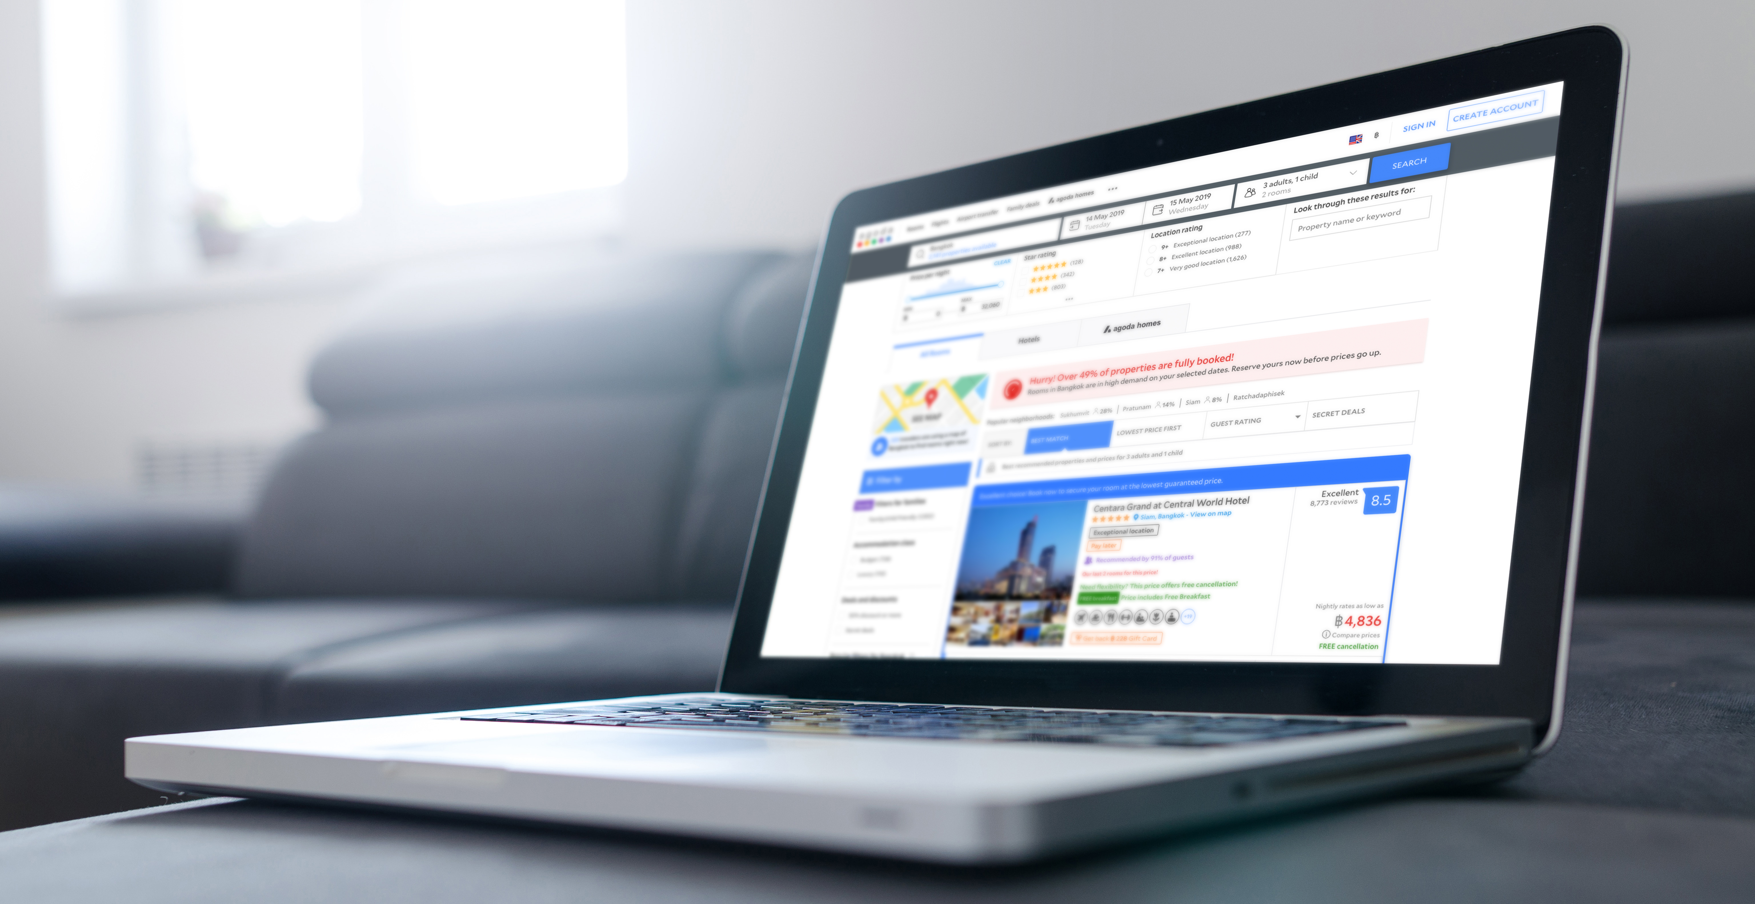


BE THE TOP HOTEL
WHEN A CUSTOMER SEARCHES IN YOUR CITY

Slide 2

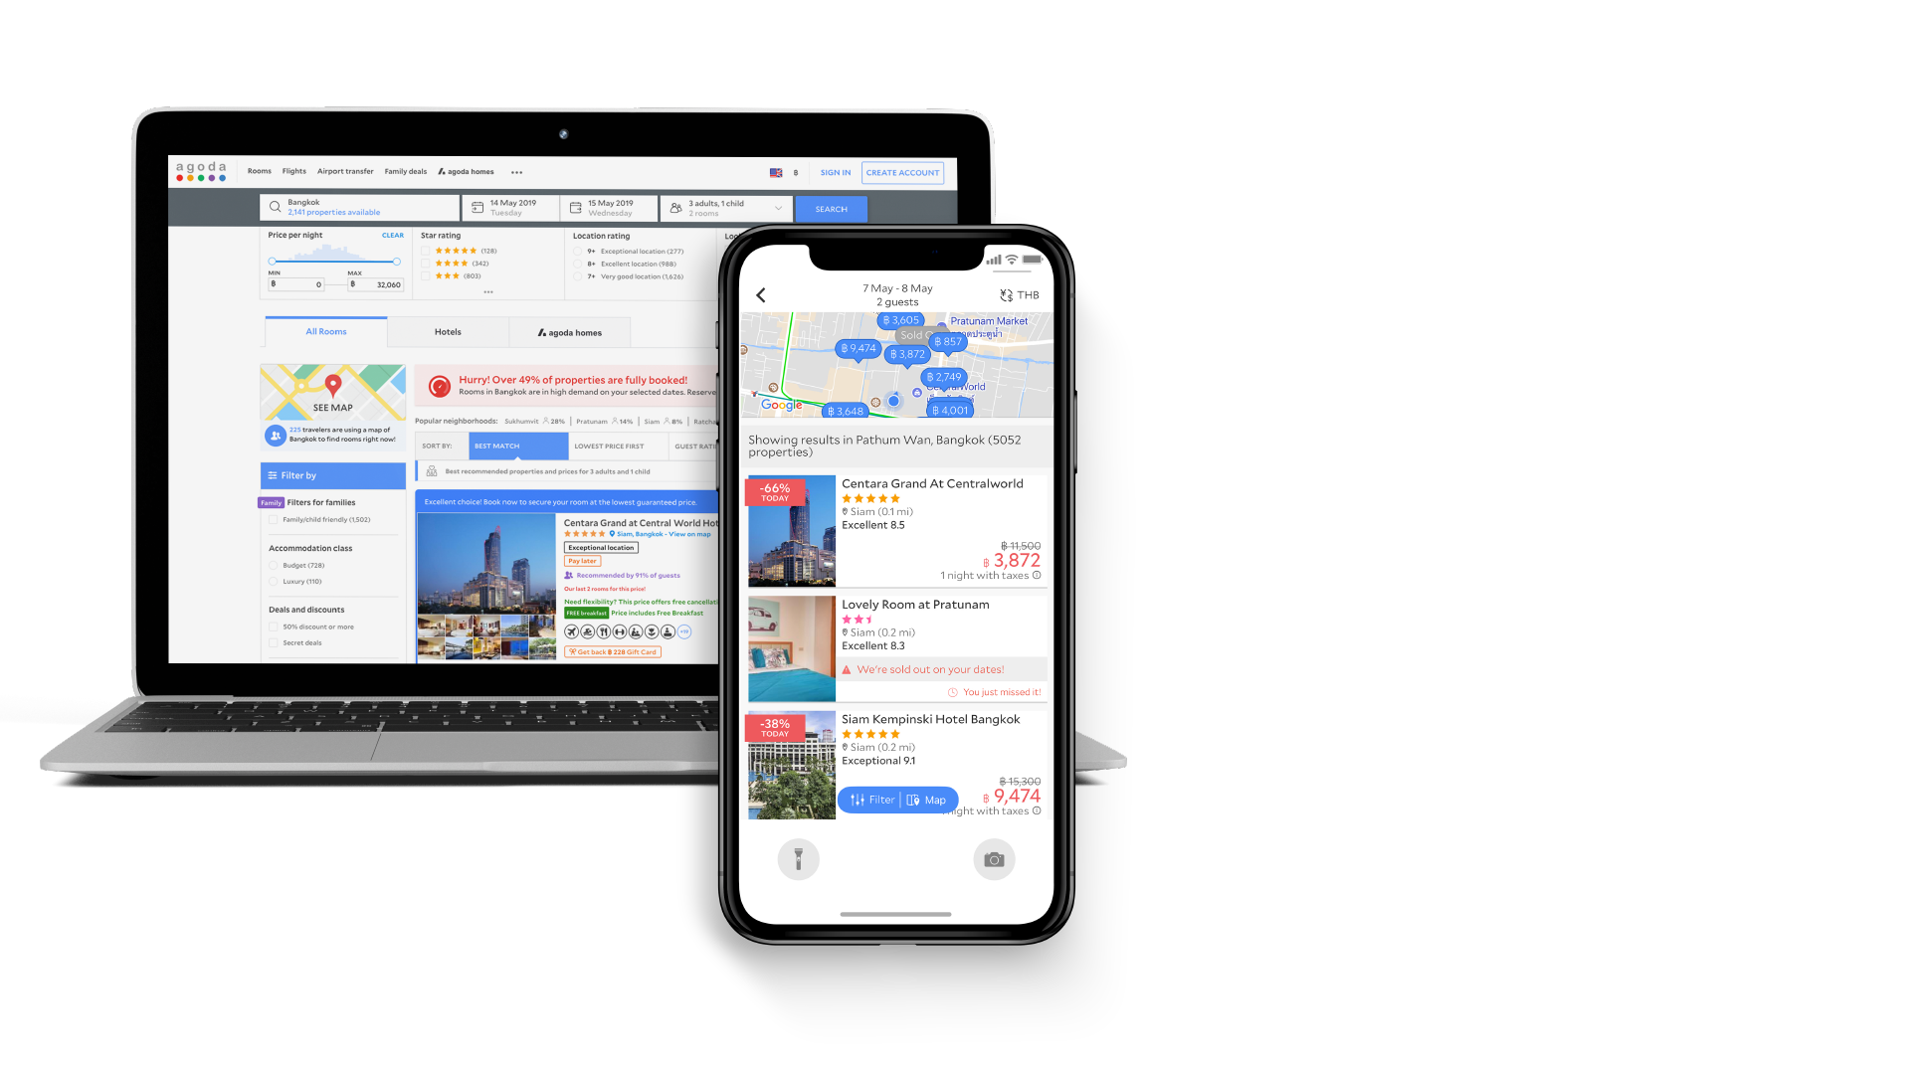

1st SPOT
• Be listed as the FIRST recommended hotel in your city
2nd – 3rd SPOT
• Be listed as the 2nd – 3rd recommended hotel in your city
Spot
1st
2nd
3rd
4-weeks
$25,000
$25,000
$25,000
2-weeks
$14,000
$ 12,000
$ 11,000
FACT : 90% of bookings from search pages happen via the 1st results page
FACT : Hotels in the top 4 spots get up to 6x more visitors than hotels on the rest of the page

Slide 3


Benefits of Sponsored Listings
• Stay ahead of your competitors! Show up on the top of the first page.
• Gain mindshare during high season, or boost bookings during low season
• Control your budget – pay one lump sum with no additional fee
• Drive traffic, bookings, and revenue
90% of bookings are with properties on the first page
Sponsored listing properties can experience up to 30x impressions and bookings with >
10x ROI

Slide 4

2
3
Make it happen
1
2
3
Inform your account manager your desired listing dates and spot (1st, 2nd or 3rd)
Sign the addendum
Enjoy the top spot for your city!

Slide 5

SUCCESSFUL
CASE STUDIES

Slide 6

Increased Traffic
>30x
Increased Bookings
A 4-Stars Chain Hotel in
Paris, France
>30x
Story:
This 4-star hotel was struggling with low visibility despite its excellent ratings and offerings. Things took a different turn after it invested in a sponsored listing, taking the 1st spot for Paris hotel searches.
ROI
>11x

Slide 7
Increased Traffic
1200%
A New Hotel in Hoi An,
Vietnam
Increased Bookings
270%
Story:
This new, boutique hotel used a Sponsored Listing in their 2nd month on Agoda to drive traffic. They were so satisfied with the result that they bought the following month’s top spot right away. That boosted the momentum further and resulted in the 2nd campaign yielding an ROI of 20x!
ROI
20x

Slide 8

Maximizing Effectiveness
Be sure to have room availability and good rates to gain the most benefit out of your sponsored listings
Consider driving bookings during a specific window -- combine sponsored listings with promotion during that period
Ask for possible special rates when buying long-term sponsored listings
Contact your Account Manager with any additional questions

