Slide 1


AGODA GROWTH EXPRESS
Boost your ranking, visibility, and earnings

Slide 2



INTRODUCTION
GROWTH EXPRESS
Agoda’s most dynamic growth tool
Create campaigns for specific travel periods
Choose the point of sale you wish to target
Implement flexible, commitment free campaigns, fully controlled by you
Gain insights on your competitors to achieve a strategic advantage
View campaign performance reports directly on YCS
FACT : 90% of bookings are made on the 1st search results page

Slide 3

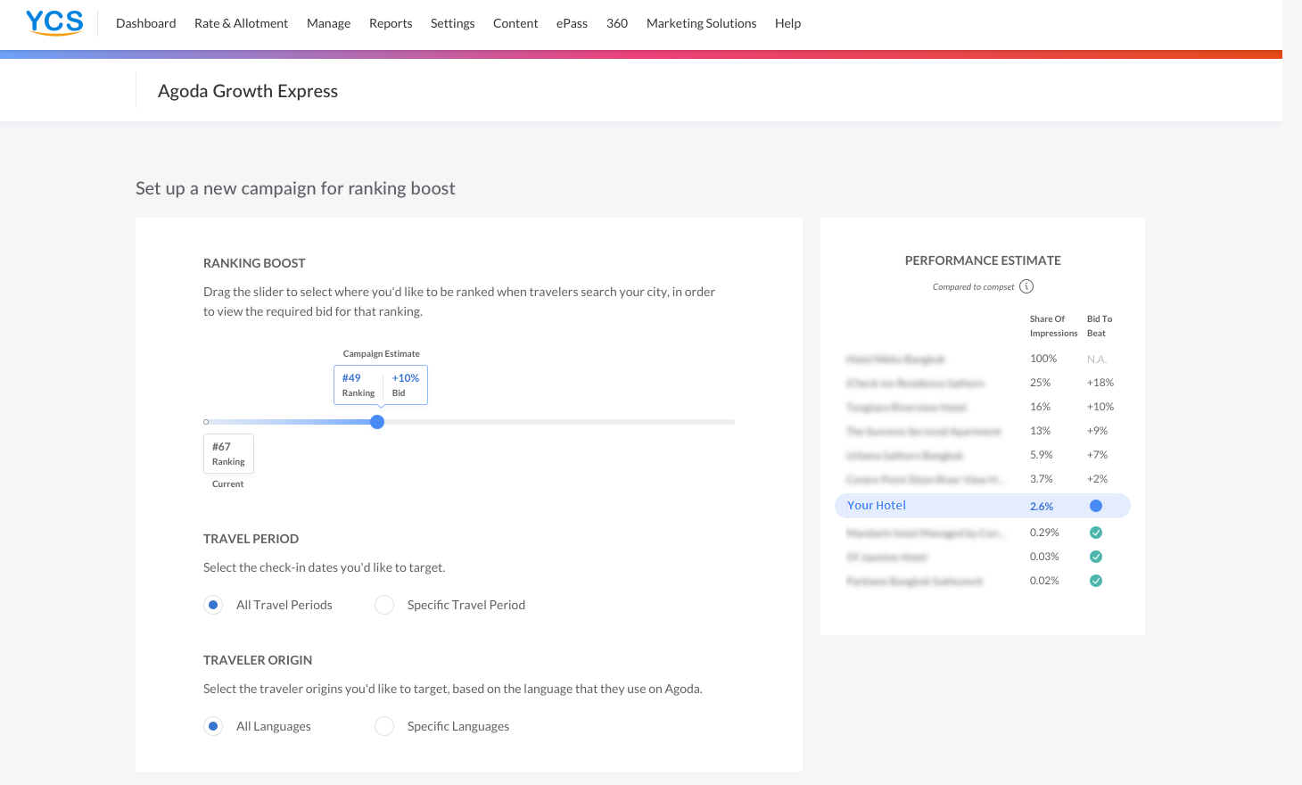
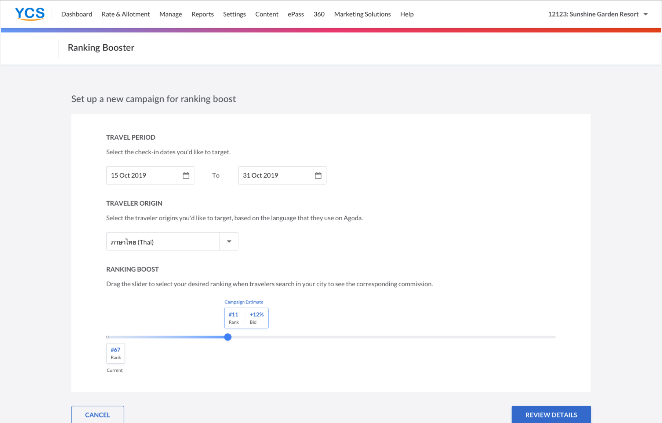
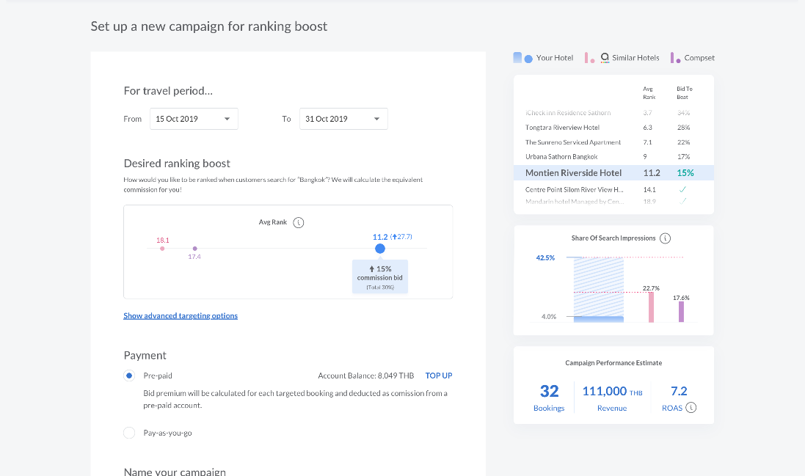
AGODA GROWTH EXPRESS
ACTIVATION PROCESS
Create your campaign on YCS
Select the travel periods, traveler origin, and your desired ranking
Notes:
Change Ranking Boost to Growth Express

Slide 4
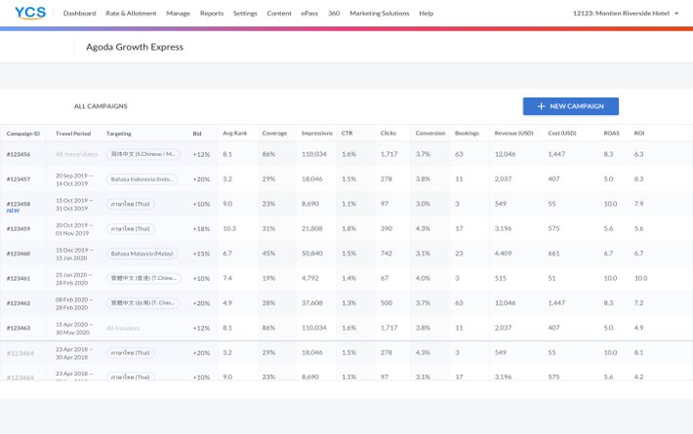
AGODA GROWTH EXPRESS
ACTIVATION PROCESS
Review and manage your campaigns!

Slide 5
Maximizing Effectiveness
Be sure to have room availability and competitive rates to gain the most benefits out of your campaigns.
Set up multiple campaigns for different periods /origins to maximize the impact.
Be the first to use this innovative tool to gain competitive advantages.
For any additional questions,
please contact your Market Manager.

