Slide 1



BOOST YOUR VISIBILITY AND PRODUCTION ON AGODA
WITH
AGODA VIP RATE CHANNEL

Slide 2
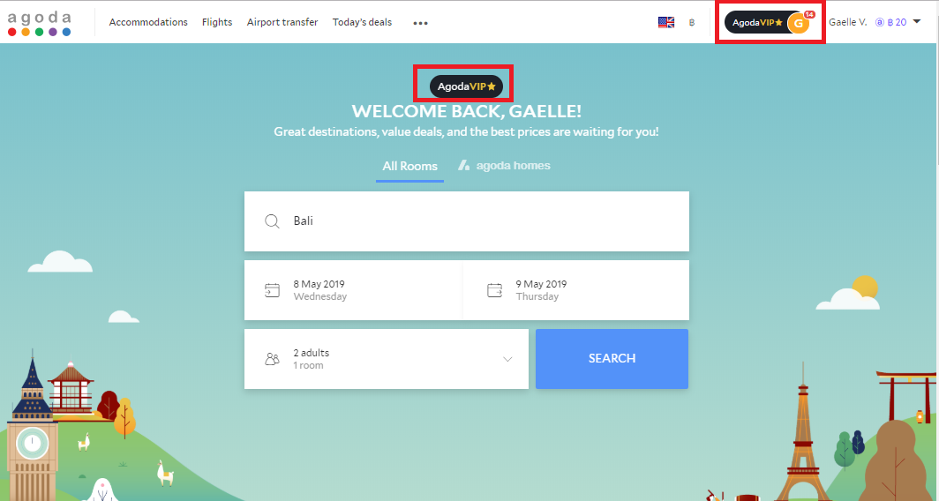
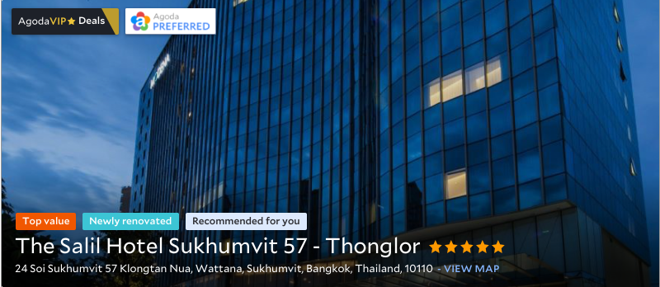
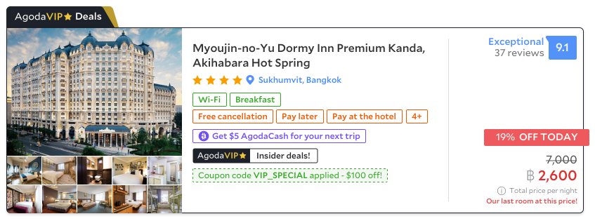
AGODA VIP IS THE NEW EXCLUSIVE OFFER FOR AGODA’S TOP CUSTOMERS WITH A MINIMUM OF 5 BOOKINGS
AgodaVIP rate is visible for these
Exclusive Customers
AgodaVIP RATE CHANNEL IS ONLY VISIBLE FOR CUSTOMERS
• Who are logged in
• Who have made more than 5 bookings in the last 2 years (not cancelled)

Slide 3
WHY YOUR HOTEL SHOULD JOIN THE AgodaVIP PROGRAM?
Participating hotels have seen +20% increase in production and +16% in revenue (after discount)
MORE PRODUCTION
BETTER VISIBILITY
Receive exclusive badges on your property
Improved Ranking from increased production
LOWER CANCELATIONS
Up to 30% lower cancellation than non VIP guests
HIGH VALUE CUSTOMERS
Attract frequent quality travelers with high purchasing power

Slide 4
WHAT ARE THE CRITERIA TO JOIN AgodaVIP?
DISCOUNT
Min allowed 15%
MAXIMUM COVERAGE
AgodaVIP rate channel is permanent. If switched off, rate channel cannot be reactivated within 2 months.
BLACK-OUT
30 black out days allowed per year

Slide 5
WHAT ARE THE CRITERIA TO JOIN AgodaVIP? PROPERTIES WITH APS
DISCOUNT
5% discount on top of your current APS
E.g., If APS activated at 10% discount then Agoda VIP 10+5=15%
APS rate channel is mandatory
MAXIMUM COVERAGE
Agoda VIP rate channel is permanent. If switched off, rate channel cannot be reactivated within 2 months.
BLACK-OUT
30 black out days allowed per year

