Slide 1


Welcome page
Accelerated
Agoda’s
most comprehensive marketing program
for selected partners

Slide 2
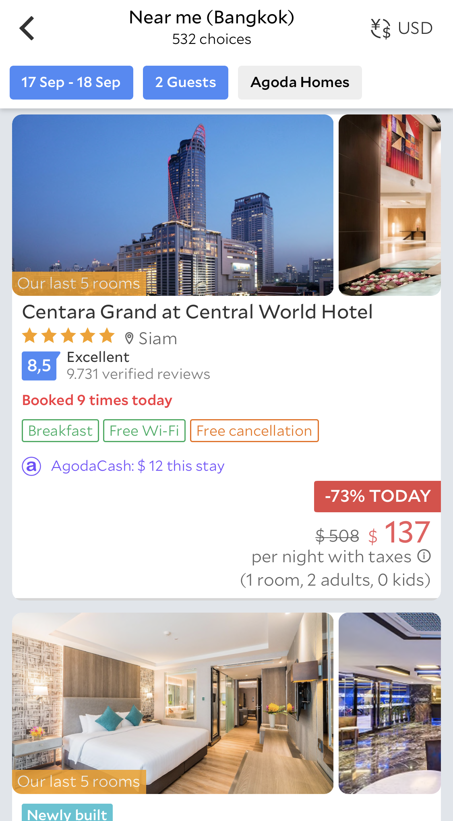
Future products
Accelerated
INCREASE ONLINE EXPOSURE
Boost impressions to increase your brand awareness and gain competitive advantages
Online Marketing
made easy
Impression growth: Global
+61.4%
Make the best use of Agoda’s online marketing capabilities and focus on yielding by staying in control of your rates
CONVERT MORE VALUABLE CUSTOMERS
Target the right audience with agoda’s advanced targeting technology and maximize your revenue
Revenue growth: Global
+56.7%
Note: All metrics are averaged out by number of hotels.
Duration 90 days from the effective date in 2019.
All material herein © 2005 - 2018 Agoda group of companies. All rights reserved. AGODA ® is a registered trademark of AGIP LLC,
used under license by Agoda Company Pte. Ltd. Agoda is part of the Booking Holdings (NASDAQ:BKNG). Internal use only. Proprietary & confidential.
2
Notes:
https://agoda-dashboard/#/views/Growthpost-AGP_0/Growthpost-AGP

Slide 3






Blank page 2
Accelerated
AGODA: BEST IN CLASS FOR ONLINE MARKETING
+4,000
Employees, including engineers and online marketing experts
+50
Offices globally
to strengthen local
marketing campaigns
+10,000
Globally affiliated partners from multiple industries
Agoda is one of the fastest growing OTAs, with the largest presence in Asia, both outbound and inbound
+15
Years of experience
in developing
state-of-the-art marketing algorithms
USD 4.96 B
Spent on online marketing, as part of Booking Holdings,
the global leader in online traveling
+ 2 million
Properties displayed on agoda.com
Note: All metrics are averaged out by number of hotels. Duration 180 days before and after from the effective date for 2018 and 2019.
All material herein © 2005 - 2018 Agoda group of companies. All rights reserved. AGODA ® is a registered trademark of AGIP LLC,
used under license by Agoda Company Pte. Ltd. Agoda is part of the Booking Holdings (NASDAQ:BKNG). Internal use only. Proprietary & confidential.
3

Slide 4



















Blank page 1
Increase exposures across all channels to maximize online visibility
Accelerated
Accelerated
Direct access
Pay-Per-Click (PPC)
Meta search (MSE)
Affiliate marketing
Customer marketing
All material herein © 2005 - 2018 Agoda group of companies. All rights reserved. AGODA ® is a registered trademark of AGIP LLC,
used under license by Agoda Company Pte. Ltd. Agoda is part of the Booking Holdings (NASDAQ:BKNG). Internal use only. Proprietary & confidential.
4

Slide 5

Team / Audience
Innovative demand driven marketing drives
higher conversion & revenue
Accelerated
PREFERRED PARTNER LOGO
ENHANCED AD SPENDING
Property highlighted with the logo for
greater visibility and higher conversion
Agoda enhances bidding on its paid channels to capture customers outside of agoda.com
BOOST IN RANKING
GREATER AFFILIATE EXPOSURE
Property boosted in ranking for greater visibility & impressions on Agoda’s website and mobile app
Property prioritized for greater visibility on affiliate platforms
“HYPER” GIFT CARDS
INCREASED EDM PRESENCE
Agoda invests further in its loyalty program to drive higher conversion
Agoda preferentially targets / retargets customers via email and other communication channels
All material herein © 2005 - 2018 Agoda group of companies. All rights reserved. AGODA ® is a registered trademark of AGIP LLC,
used under license by Agoda Company Pte. Ltd. Agoda is part of the Booking Holdings (NASDAQ:BKNG). Internal use only. Proprietary & confidential.
5

Slide 6
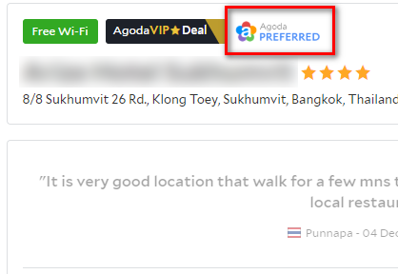
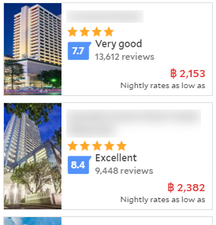

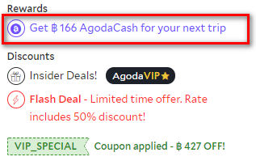
Team / Audience
Accelerated
DIRECT ACCESS
Preferred Partner logo
Increase your conversion rate with
the Preferred Partner logo
Boost in ranking
Appear higher in the search results with the ranking boost
Hyper gift cards
Incentivize potential customers with up to 2.5X higher AgodaCash amount
All material herein © 2005 - 2018 Agoda group of companies. All rights reserved. AGODA ® is a registered trademark of AGIP LLC,
used under license by Agoda Company Pte. Ltd. Agoda is part of the Booking Holdings (NASDAQ:BKNG). Internal use only. Proprietary & confidential.
6

Slide 7











Team / Audience
Accelerated
ENHANCED AD SPENDING
Let Agoda help you invest more in the most effective way
with its data driven bidding algorithm
1.7 X
2.5 X
1.7 times more spending on
Pay-Per-Click and Cost-Per-Click
2.5 times the spending on
Meta Search engines
All material herein © 2005 - 2018 Agoda group of companies. All rights reserved. AGODA ® is a registered trademark of AGIP LLC,
used under license by Agoda Company Pte. Ltd. Agoda is part of the Booking Holdings (NASDAQ:BKNG). Internal use only. Proprietary & confidential.
7

Slide 8

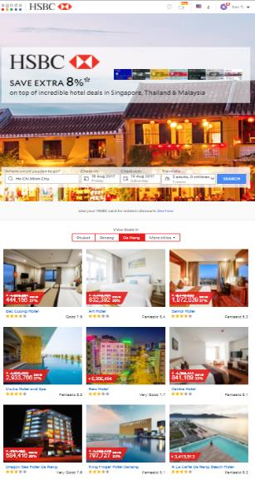
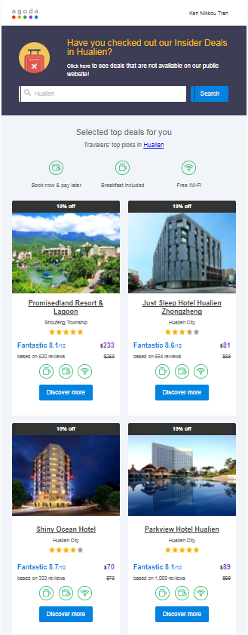










Team / Audience
Accelerated
GREATER AFFLIATE EXPOSURE
Increased exposure via our vast affiliate network
Prioritized affiliate campaigns for AGP properties
All material herein © 2005 - 2018 Agoda group of companies. All rights reserved. AGODA ® is a registered trademark of AGIP LLC,
used under license by Agoda Company Pte. Ltd. Agoda is part of the Booking Holdings (NASDAQ:BKNG). Internal use only. Proprietary & confidential.
7

Slide 9
Blank page 1
Impression, room nights, revenue growth
Before & After AGP (2019)
Accelerated
GLOBAL
IMPRESSION
+64.1%
ROOM NIGHTS
+38.4%
REVENUE
+33.9%
(SUPPLIER TOTAL AMOUNT)
+64.1%
+38.4%
+33.9%
Before
After
Impression
Room Nights
Revenue
Note: All metrics are averaged out by number of hotels. Duration 90 days from all effective dates in 2019.
All material herein © 2005 - 2018 Agoda group of companies. All rights reserved. AGODA ® is a registered trademark of AGIP LLC,
used under license by Agoda Company Pte. Ltd. Agoda is part of the Booking Holdings (NASDAQ:BKNG). Internal use only. Proprietary & confidential.
9
Notes:
https://agoda-dashboard/#/views/BeforeAfterAGP/AllAGPHotelBeforeAfterYOY?:iid=2

Slide 10






Blank page 1
Let Agoda help you achieve your targets
Accelerated
Increase
brand awareness
Increase
occupancy
Increase
length of stay
The advanced marketing solutions of AGP has helped hotels reach these objectives:
Increase average daily rate
Increase
lead time
Increase
inbound guests
All material herein © 2005 - 2018 Agoda group of companies. All rights reserved. AGODA ® is a registered trademark of AGIP LLC,
used under license by Agoda Company Pte. Ltd. Agoda is part of the Booking Holdings (NASDAQ:BKNG). Internal use only. Proprietary & confidential.
10

Slide 11
Blank page 2
AGP Hotels achieve higher YoY growth and
lead the market growth with Agoda
Global
YoY ROOM NIGHTS GROWTH%
AGP VS NON-AGP
YoY GROWTH IN AUGUST:
PAGE VIEWS
AGP Hotels
Non-AGP Hotels
+88%
+9%
vs
AGP
ROOM NIGHTS
AGP Hotels
Non-AGP Hotels
+41%
+12%
vs
Non-AGP
REVENUE
18-Jul
18-Aug
18-Sep
18-Oct
18-Nov
18-Dec
19-Jan
19-Feb
19-Mar
19-Apr
19-May
19-Jun
19-Jul
19-Aug
AGP Hotels
Non-AGP Hotels
+33%
+12%
All material herein © 2005 - 2018 Agoda group of companies. All rights reserved. AGODA ® is a registered trademark of AGIP LLC,
used under license by Agoda Company Pte. Ltd. Agoda is part of the Booking Holdings (NASDAQ:BKNG). Internal use only. Proprietary & confidential.
vs
Notes:
https://agoda-dashboard/#/views/AGPvsNon-AGPGrowth/AGPOverviewGrowth?:iid=3

Slide 12
Blank page 2
AGP helps attract more inbound customers
with higher ADR, lead time and LOS
Accelerated
Global
Nationality mix
AGP vs Non-AGP hotels
+8%
Length of Stay Domestic vs. Inbound
Inbound
Domestic
Inbound
Domestic
AGP
Non-AGP
Lead time Domestic vs. Inbound
Average ADR
Domestic vs Inbound
+34.5%
Domestic
Inbound
Domestic
Inbound
All material herein © 2005 - 2018 Agoda group of companies. All rights reserved. AGODA ® is a registered trademark of AGIP LLC,
used under license by Agoda Company Pte. Ltd. Agoda is part of the Booking Holdings (NASDAQ:BKNG). Internal use only. Proprietary & confidential.
Notes:
https://agoda-dashboard/#/views/DomesticvsInboundAnalysis/DomesticvsInboundAnalysis?:iid=1

Slide 13


Blank page 2
Prepayment option available for cashflow improvements
Accelerated
AGP prepayment options contribute to your cashflow, offering options for you to make investments on your property
We are confident in our partnership & growth potentials
… and are willing to offer you a upfront payment of your future revenue
All material herein © 2005 - 2018 Agoda group of companies. All rights reserved. AGODA ® is a registered trademark of AGIP LLC,
used under license by Agoda Company Pte. Ltd. Agoda is part of the Booking Holdings (NASDAQ:BKNG). Internal use only. Proprietary & confidential.
6

Slide 14
Blank page 1
Multiple program options available to suit your operational conveniences
Accelerated
Contract
Type
Marketing
Boost
Sell Rates &
Inventory control
Payment
Method
Open End
Commission Override
Prepayment:
Auto Renewal
Commission Override
Flexi Fix
Commission Override
AGODA
GROWTH
PROGRAM
Open End
Commission Override
No
Prepayment:
Invoice Pre-paid
Invoice
(Fixed subscription fee)
Invoice Post-paid
Invoice
(Production based)
All material herein © 2005 - 2018 Agoda group of companies. All rights reserved. AGODA ® is a registered trademark of AGIP LLC,
used under license by Agoda Company Pte. Ltd. Agoda is part of the Booking Holdings (NASDAQ:BKNG). Internal use only. Proprietary & confidential.
14

